Slide 1


JAVAFX

Slide 2

JavaFX
JavaFX is a Java library used to build Rich Internet Applications. The applications written using this library can run consistently across multiple platforms. The applications developed using JavaFX can run on various devices such as Desktop Computers, Mobile Phones, TVs, Tablets, etc.
JavaFx provides a variety of UI controls that allow a smooth interaction between users and applications.
JavaFx provides various pre-defined classes that represents different types of shapes
In JavaFx, effects are used to enhance the visual appearance of nodes.
Generally, animations are used to create special visual effects to the elements like images, text, drawings, etc.

Slide 3
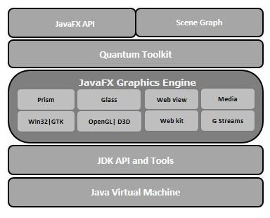
JavaFX Architecture
javafx.application − Contains a set of classes responsible for the JavaFX application life cycle.
javafx.css − Contains classes to add CSS–like styling to JavaFX GUI applications.
javafx.event − Contains classes and interfaces to deliver and handle JavaFX events.
javafx.stage − This package holds the top level container classes for JavaFX application.
javafx.scene − This package provides classes and interfaces to support the scene graph. In addition, it also provides sub-packages such as canvas, chart, control, effect, image, input, layout, media, paint, shape, text, transform, web, etc. There are several components that support this rich API of JavaFX.

Slide 4
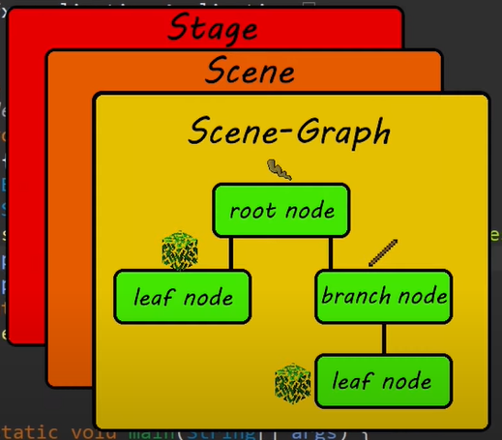
JavaFX GUI Layers
Stage is a top level container similar to a Window
A scene is a drawing surface for graphical contents
A Scene Graph is a hierarchical tree of nodes. It is a tree data structure that holds and arranges nodes.
Nodes are components that are added to a scene

Slide 5
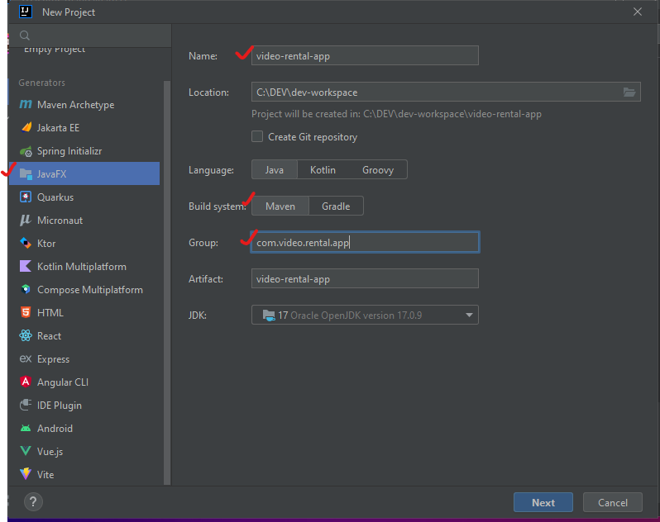
Creating a JavaFX project
Launch IntelliJ
Create New Project
On the left panel, under Generators, select JavaFX
Provide the project name, select Maven as Build option and input group name.
Click on Next

Slide 6
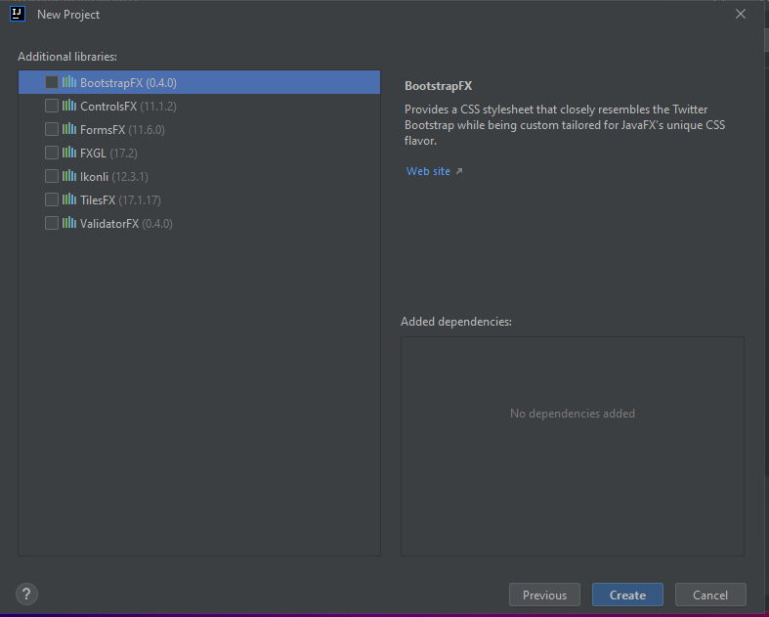
Creating a JavaFX project
In the next wizard window, there is no need to put additional binaries right now so let all checkboxes unchecked
Click on Create

Slide 7
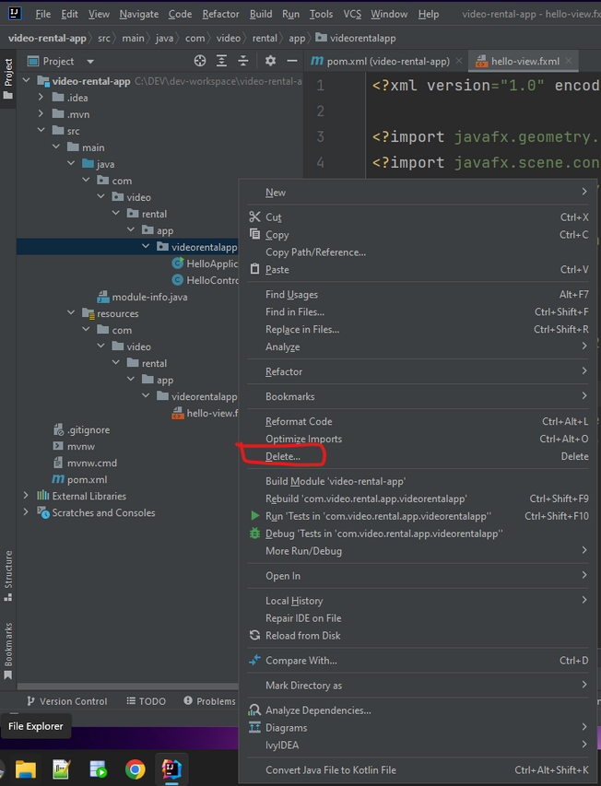
Creating a JavaFX project
The default project structure comes with default classes. Locate the HelloApplication.java and HelloController.java files and delete them from their package

Slide 8
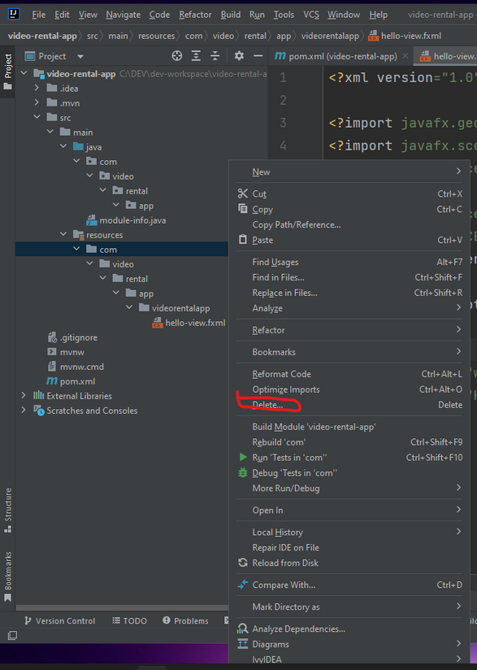
Creating a JavaFX project
In src > main > resources delete everything starting from the highest directory so it leaves the resources directory empty

Slide 9
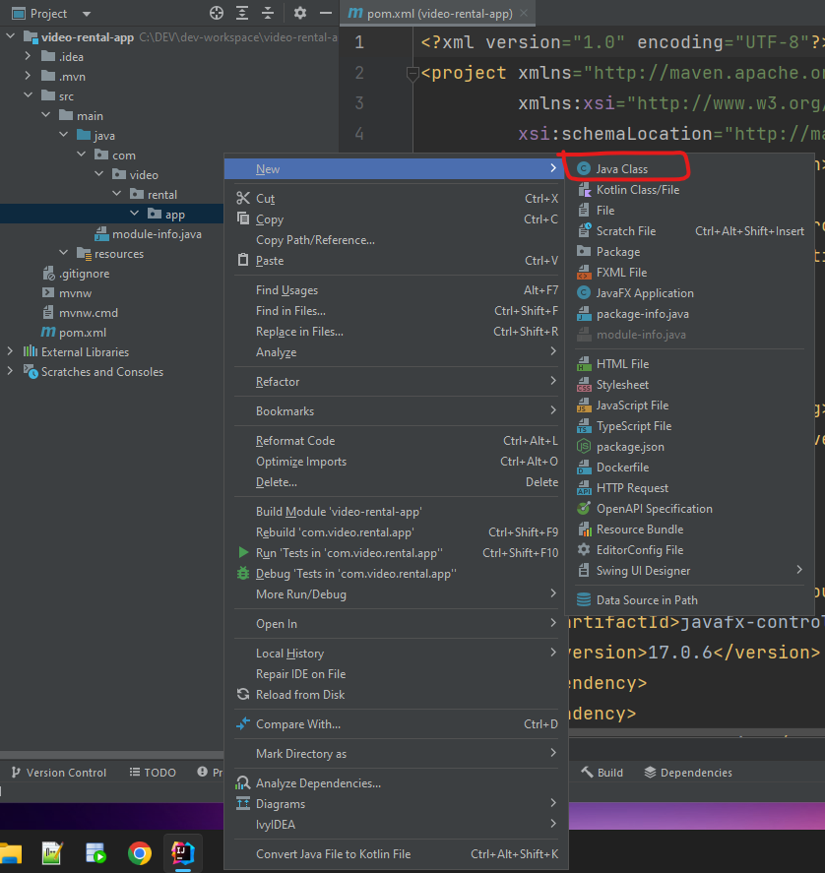
Creating a JavaFX project
Create the Main.java file in the current package (i.e com.video.rental.app.Main.java)

Slide 10
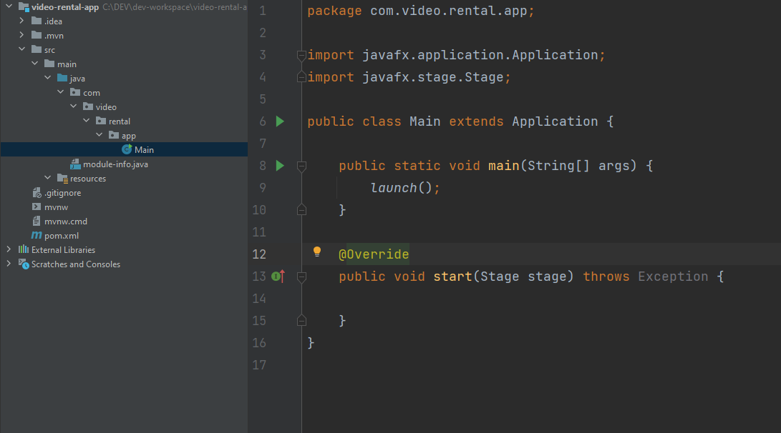
Creating a JavaFX project
In the Main.java, extend Application class.
Then implement the start() method with empty body
Then create the main method that calls the launch() method from the parent Application class.

Slide 11
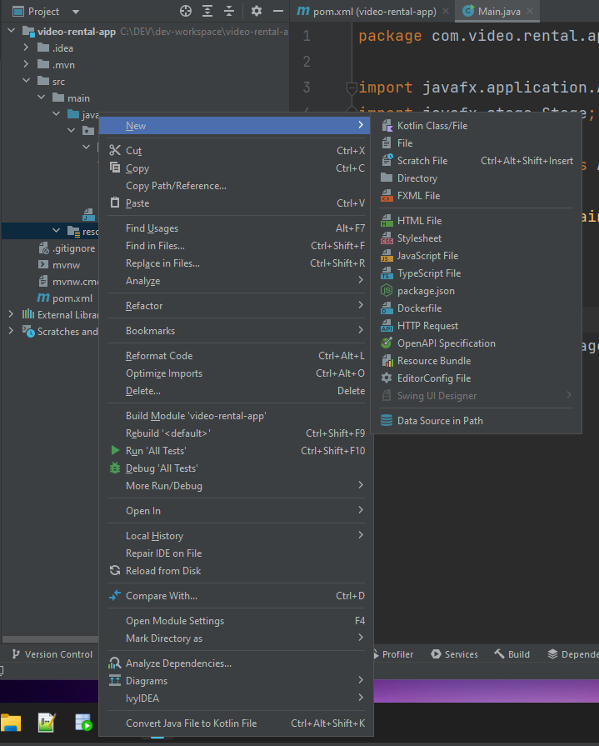
Creating a JavaFX project
From the resources directory, right click and create a new directory and name it views

Slide 12
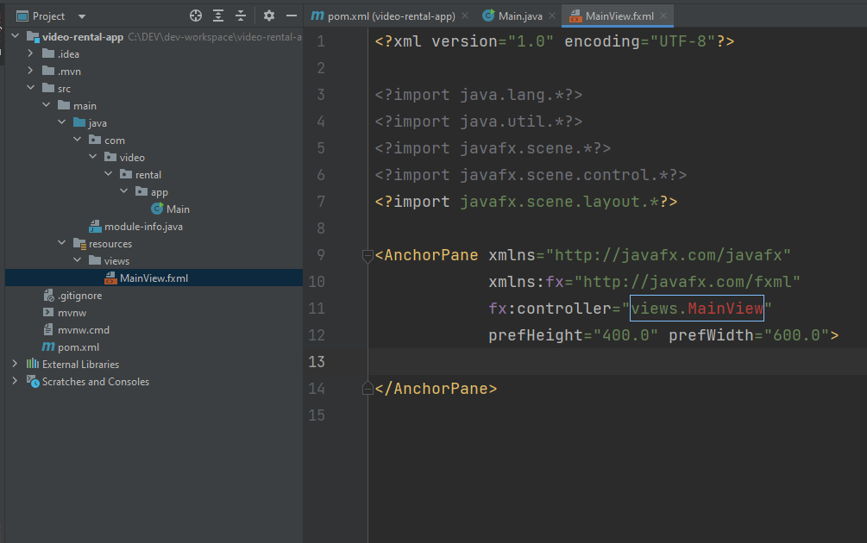
Creating a JavaFX project
From resources > views, right click and create a new FXML file and name it MainView
Delete all the contents of the MainView.fxml file except the first line.

Slide 13
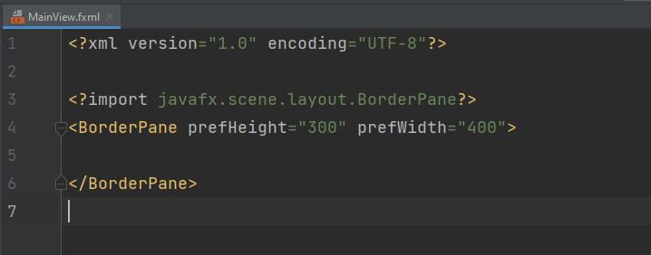
Creating a JavaFX project
Open the MainView.fxml file and create a BorderPane tag that has the following properties set:
prefHeight = “300”
prefWidth=”400”

Slide 14
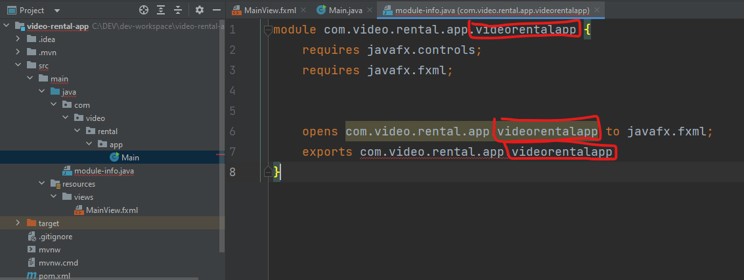
Creating a JavaFX project
Some errors might be present during compile time - one is error in the module-info.java. This file shows all the modules required in the application.
By default, this file adds modules according to the default packages when the project is created. It needs to be adjusted as files and packages are added and deleted.

Slide 15
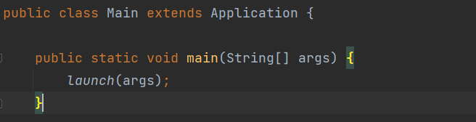
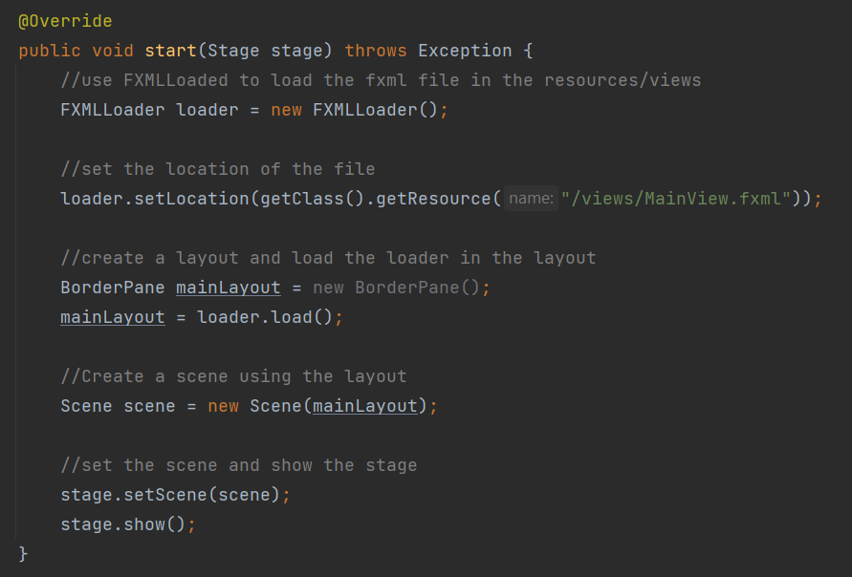
The Main class
The Main class has 2 methods:
The main method which is the entry point of the application. This method calls the static launch method from the parent class which is the Application class
Behind the scenes of the implementation of the launch class, the start method will soon be called and this comes with a default stage that the application will use. This start method shall be overridden in the Main class for it to be implemented in the app.

Slide 16
JavaFX Stage
JavaFX Stage Documentation: https://openjfx.io/javadoc/12/javafx.graphics/javafx/stage/Stage.html
JavaFX Sample Usages:
https://jenkov.com/tutorials/javafx/stage.html

Slide 17
JavaFX Scene Layouts (Containers)
JavaFX provides several predefined layouts such as HBox, VBox, Border Pane, Stack Pane, Text Flow, Anchor Pane, Title Pane, Grid Pane, Flow Panel, etc.
Each of the above mentioned layout is represented by a class and all these classes belongs to the package javafx.layout. The class named Pane is the base class of all the layouts in JavaFX.
https://www.tutorialspoint.com/javafx/javafx_layout_panes.htm
https://docs.oracle.com/javafx/2/layout/builtin_layouts.htm

Slide 18
JavaFX UI Controls
Every user interface considers the following three main aspects
UI elements − These are the core visual elements which the user eventually sees and interacts with. JavaFX provides a huge list of widely used and common elements varying from basic to complex, which we will cover in this tutorial.
Layouts − They define how UI elements should be organized on the screen and provide a final look and feel to the GUI (Graphical User Interface). This part will be covered in the Layout chapter.
Behavior − These are events which occur when the user interacts with UI elements. This part will be covered in the Event Handling chapter.
https://www.tutorialspoint.com/javafx/javafx_ui_controls.htm
https://docs.oracle.com/javafx/2/get_started/fxml_tutorial.htm

Slide 19
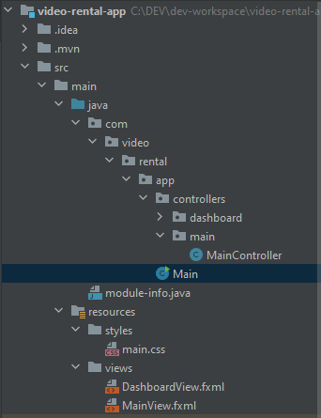
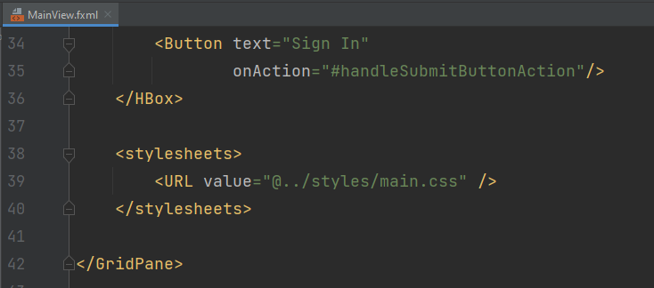
Styling the App with CSS
Add the css files in resources > styles
Use the css files by adding its location at the fxml file inside the stylesheets tag at the end of the root of the fxml tag
Use URL value=”@location” format to point the location of the sylesheet

Slide 20
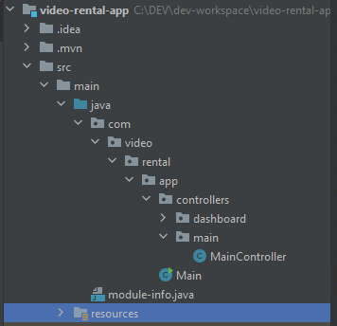
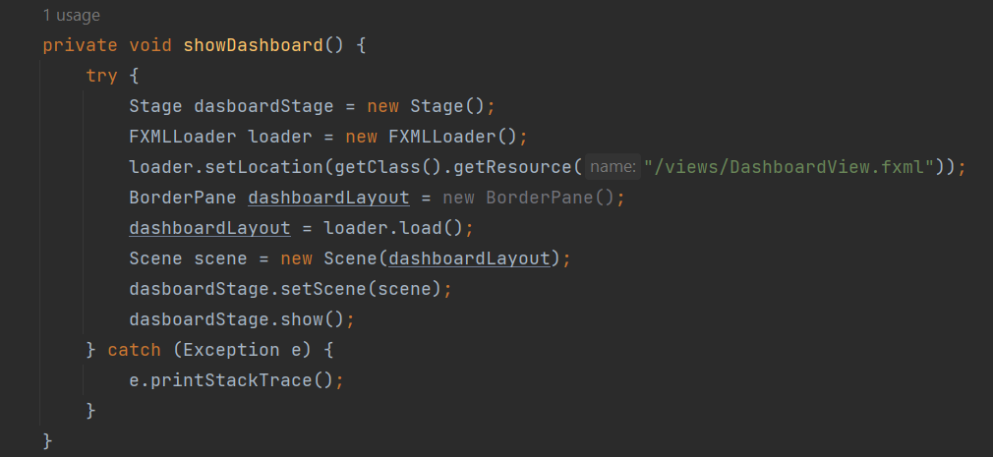
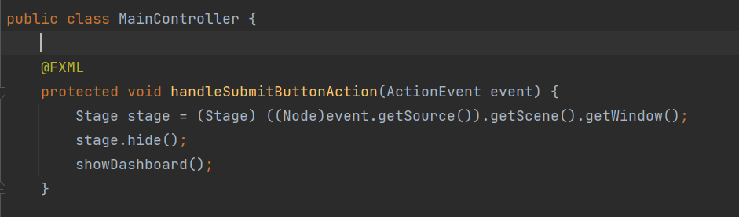
Adding Controllers
Create a package for controllers
Add the controller to the root of the fxml file

Slide 21
To be continued

